Slide 1

6th Grade Accelerated Math
Unit 2, Lesson 7 Solving Multi‑Step, Real-World Problems With Fractions or Decimals Volume 1, pg. 68

Slide 2


Benchmark
MA.6.NSO.2.3 Solve multi-step, real-world problems involving any of the four operations with positive multi-digit decimals or positive fractions, including mixed numbers.
volume 1, pg. 68

Slide 3
Integrated Mathematical Thinking and Reasoning Standards
MA.K12.MTR.3.1 Complete tasks with mathematical fluency.
MA.K12.MTR.4.1 Engage in discussions that reflect on the mathematical thinking of self and others.
MA.K12.MTR.6.1 Assess the reasonableness of solutions.
MA.K12.MTR.7.1 Apply mathematics to real-world contexts.
volume 1, pg. 68

Slide 4

Learning Target
I can solve real-world problems with three steps using decimals or fractions.
volume 1, pg. 68

Slide 5

Warm-Up
volume 1, pg. 69

Slide 6
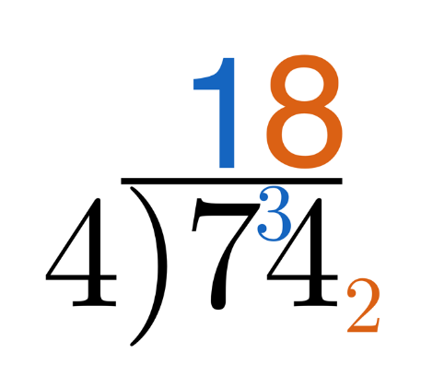

2.7.1 Warm-Up: Short Division
In Mexico, when dividing by a single-digit divisor, sometimes a method called “short division” is used. Consider the example shown of $74÷4$.
Using your knowledge of division, explain where you think the $1$, $3$, $8$, and $2$ came from in the process.
volume 1, pg. 69

Slide 7
Show how you might represent the same division problem using a method different from “short division.”
volume 1, pg. 69

Slide 8

Guided Instruction
volume 1, pg. 69

Slide 9
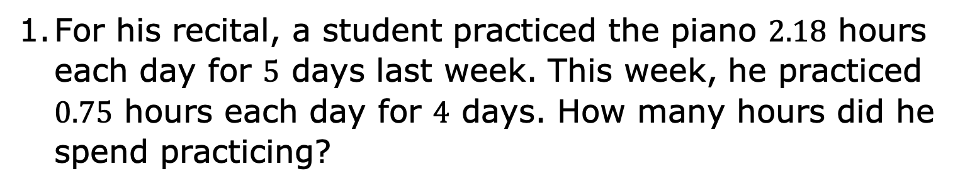
2.7.2 Guided Instruction: Three-Step Rational Problems
For his recital, a student practiced the piano $2.18$ hours each day for $5$ days last week. This week, he practiced $0.75$ hours each day for $4$ days. How many hours did he spend practicing?
volume 1, pg. 69

Slide 10
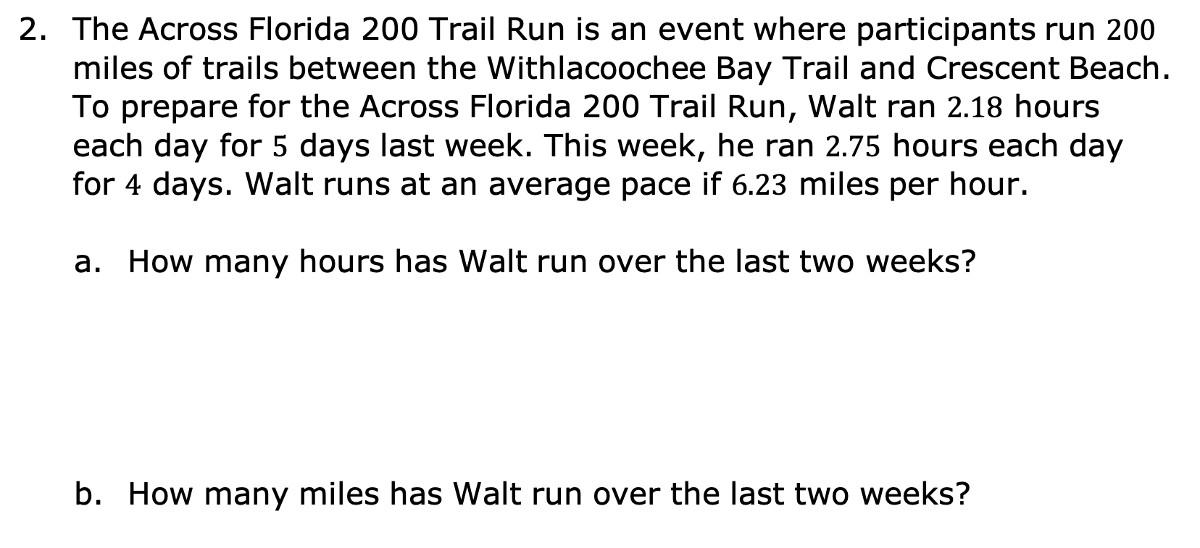
The Across Florida 200 Trail Run is an event where participants run $200$ miles of trails between the Withlacoochee Bay Trail and Crescent Beach. To prepare for the Across Florida 200 Trail Run, Walt ran $2.18$ hours each day for $5$ days last week. This week, he ran $2.75$ hours each day for $4$ days. Walt runs at an average pace if $6.23$ miles per hour.
How many hours has Walt run over the last two weeks?
How many miles has Walt run over the last two weeks?
volume 1, pg. 70

Slide 11
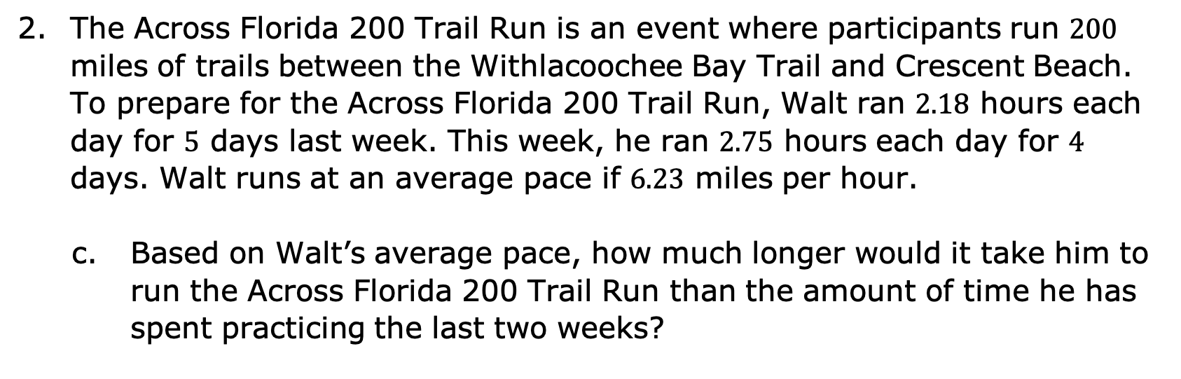
The Across Florida 200 Trail Run is an event where participants run $200$ miles of trails between the Withlacoochee Bay Trail and Crescent Beach. To prepare for the Across Florida 200 Trail Run, Walt ran $2.18$ hours each day for $5$ days last week. This week, he ran $2.75$ hours each day for $4$ days. Walt runs at an average pace if $6.23$ miles per hour.
Based on Walt’s average pace, how much longer would it take him to run the Across Florida 200 Trail Run than the amount of time he has spent practicing the last two weeks?
volume 1, pg. 70

Slide 12

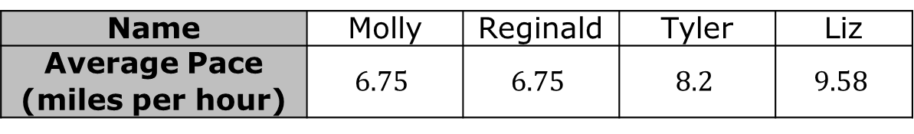
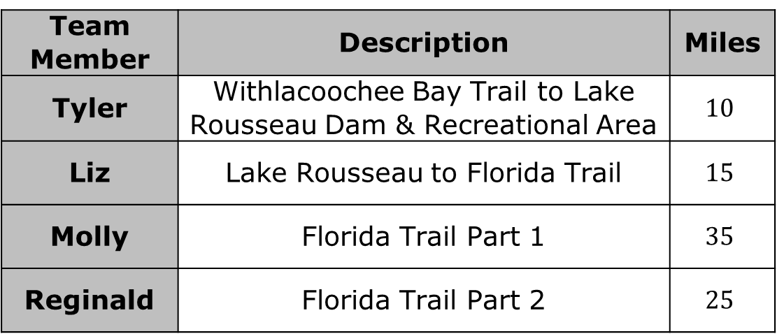
The Across Florida 200 Trail Run offers a team competition where a team of $4$ runners take turns to run the $200$ miles.
A team of runners and their average pace is shown.
To prepare for the race the team ran part of the trail.
How long did it take the team to run the practice run of $85$ miles?
Name | Molly | Reginald | Tyler | Liz
Average Pace (miles per hour) | $$6.75$$ | $$6.75$$ | $$8.2$$ | $$9.58$$
Team Member | Description | Miles
Tyler | Withlacoochee Bay Trail to Lake Rousseau Dam & Recreational Area | $$10$$
Liz | Lake Rousseau to Florida Trail | $$15$$
Molly | Florida Trail Part 1 | $$35$$
Reginald | Florida Trail Part 2 | $$25$$
volume 1, pg. 70

Slide 13

Collaboration
volume 1, pg. 71

Slide 14

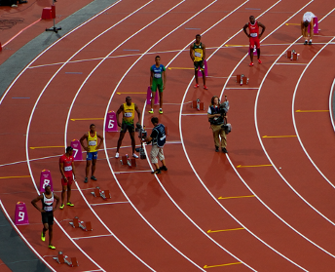
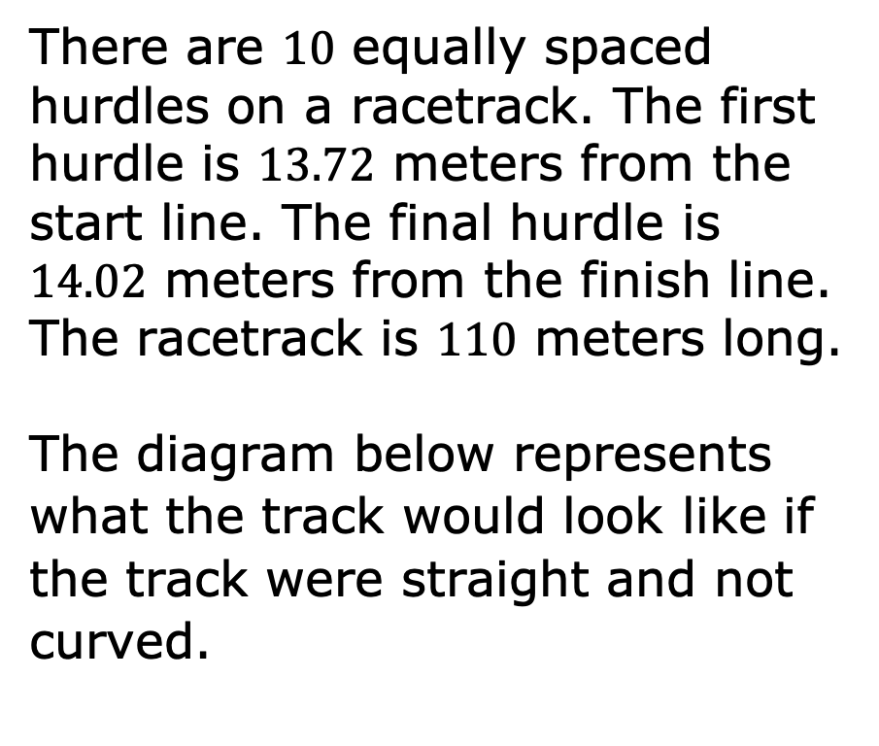
2.7.3 Collaboration: Distance Between Two Hurdles
There are $10$ equally spaced hurdles on a racetrack. The first hurdle is $13.72$ meters from the start line. The final hurdle is $14.02$ meters from the finish line. The racetrack is $110$ meters long.
The diagram below represents what the track would look like if the track were straight and not curved.
volume 1, pg. 71

Slide 15
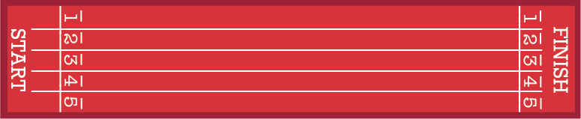
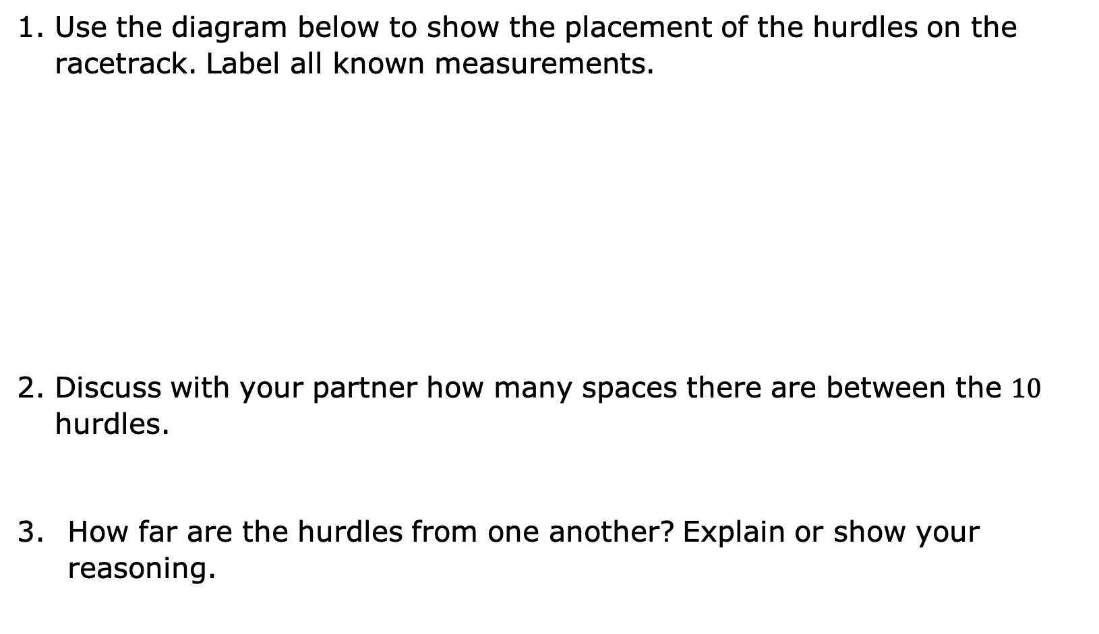
Use the diagram below to show the placement of the hurdles on the racetrack. Label all known measurements.
Discuss with your partner how many spaces there are between the $10$ hurdles.
How far are the hurdles from one another? Explain or show your reasoning.
volume 1, pg. 71

Slide 16
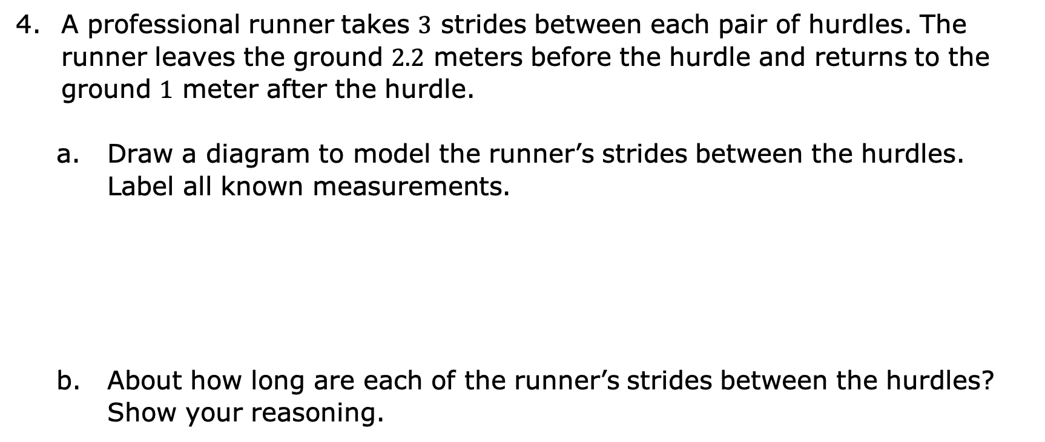
A professional runner takes $3$ strides between each pair of hurdles. The runner leaves the ground $2.2$ meters before the hurdle and returns to the ground $1$ meter after the hurdle.
Draw a diagram to model the runner’s strides between the hurdles. Label all known measurements.
About how long are each of the runner’s strides between the hurdles? Show your reasoning.
volume 1, pg. 71

Slide 17

Your Turn
volume 1, pg. 72

Slide 18
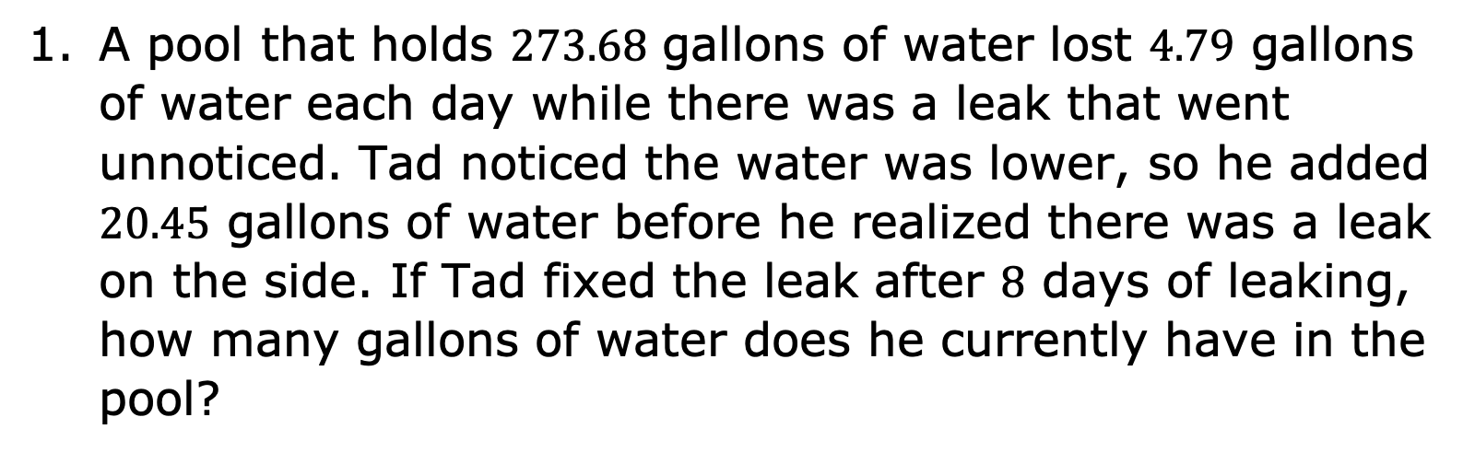
2.7.4 Your Turn!
A pool that holds $273.68$ gallons of water lost $4.79$ gallons of water each day while there was a leak that went unnoticed. Tad noticed the water was lower, so he added $20.45$ gallons of water before he realized there was a leak on the side. If Tad fixed the leak after $8$ days of leaking, how many gallons of water does he currently have in the pool?
volume 1, pg. 72

Slide 19
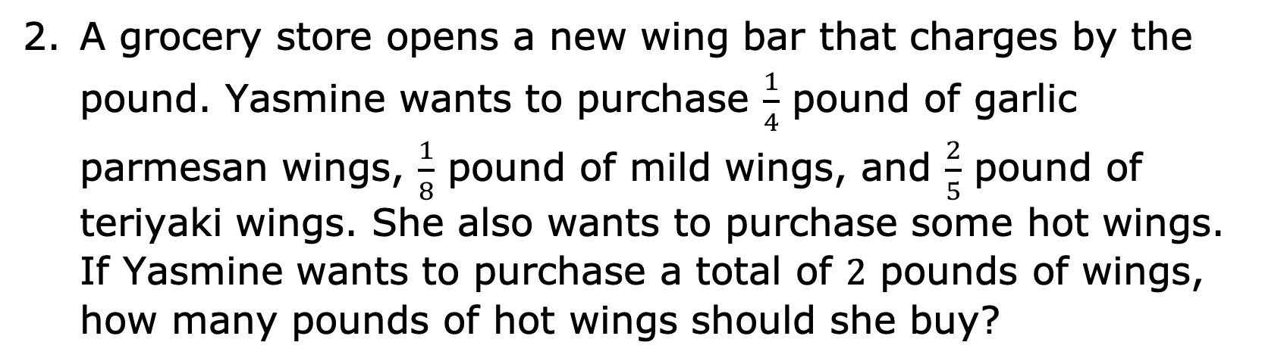
A grocery store opens a new wing bar that charges by the pound. Yasmine wants to purchase $\frac{1}{4}$ pound of garlic parmesan wings, $\frac{1}{8}$ pound of mild wings, and $\frac{2}{5}$ pound of teriyaki wings. She also wants to purchase some hot wings. If Yasmine wants to purchase a total of $2$ pounds of wings, how many pounds of hot wings should she buy?
volume 1, pg. 72

Slide 20

Wrap-Up
volume 1, pg. 72

Slide 21
2.7.5 Wrap-Up: Cool Down
For each statement, write whether you agree with it, disagree with it, or are unsure.
Statement | Agree/Disagree/Unsure
The more digits a number has, the larger it is.
When you add two positive decimals together, the value is always larger.
To add fractions, their denominators must be the same.
The product of two fractions is always a larger number.
When you put a zero on the end of any number, it makes it larger.
volume 1, pg. 72

